Slide 1
Thresholds of motion

Slide 2
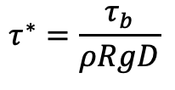
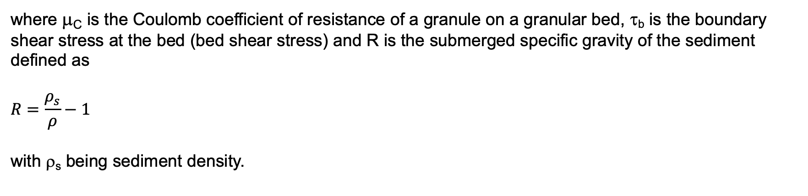
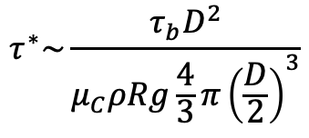
The Shields number
We defined the Shields number as
$$τ^{∗}=\frac{τ_{b}}{ρRgD}$$
It can be interpreted as a ratio scaling the impelling flow drag acting on the grain to the resistive Coulomb force
$$τ^{∗}\sim \frac{τ_{b}D^{2}}{μ_{C}ρRg\frac{4}{3}π{\left(\frac{D}{2}\right)}^{3}}$$
where μ_{C} is the Coulomb coefficient of resistance of a granule on a granular bed, τ_{b} is the boundary shear stress at the bed (bed shear stress) and R is the submerged specific gravity of the sediment defined as
$$R=\frac{ρ_{s}}{ρ}−1$$
with ρ_{s} being sediment density.

Slide 3
Angle of repose, threshold of motion in standing water
A pile of sediment resting at an angle equal to the angle of repose θ_{r} is at a threshold condition, that is a little disturbance cause the sediment to move (failure).
Here we consider a pile of sediment in standing water.
θ_{r}
θ_{r}

Slide 4
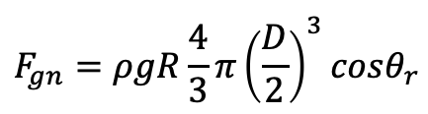
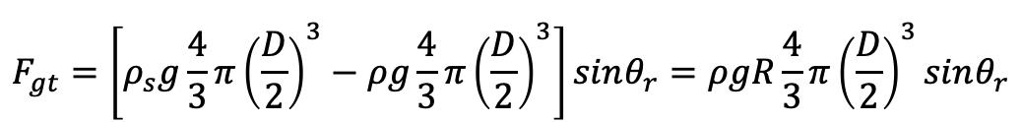
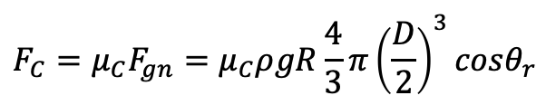
Angle of repose, threshold of motion in standing water
A pile of sediment resting at an angle equal to the angle of repose θ_{r} is at a threshold condition, that is a little disturbance cause the sediment to move (failure).
Here we consider a pile of sediment in standing water.
F_{C}
The forces acting on each grain are the net (gravitational force - buoyancy) downslope gravitational force F_{gt}, the net normal force F_{gn} and the resistive Coulomb force F_{C}.
F_{gn}
F_{gt}
$$F_{gt}=\left[ρ_{s}g\frac{4}{3}π{\left(\frac{D}{2}\right)}^{3}−ρg\frac{4}{3}π{\left(\frac{D}{2}\right)}^{3}\right]sinθ_{r}=ρgR\frac{4}{3}π{\left(\frac{D}{2}\right)}^{3}sinθ_{r}$$
θ_{r}
θ_{r}
$$F_{gn}=ρgR\frac{4}{3}π{\left(\frac{D}{2}\right)}^{3}cosθ_{r}$$
$$F_{C}=μ_{C}F_{gn}=μ_{C}ρgR\frac{4}{3}π{\left(\frac{D}{2}\right)}^{3}cosθ_{r}$$

Slide 5

Angle of repose, threshold of motion in standing water
A pile of sediment resting at an angle equal to the angle of repose θ_{r} is at a threshold condition, that is a little disturbance cause the sediment to move (failure).
Here we consider a pile of sediment in standing water.
F_{C}
The forces acting on each grain are the net (gravitational force - buoyancy) downslope gravitational force F_{gt}, the net normal force F_{gn} and the resistive Coulomb force F_{C}.
F_{gn}
F_{gt}
$$F_{gt}=\left[ρ_{s}g\frac{4}{3}π{\left(\frac{D}{2}\right)}^{3}−ρg\frac{4}{3}π{\left(\frac{D}{2}\right)}^{3}\right]sinθ_{r}=ρgR\frac{4}{3}π{\left(\frac{D}{2}\right)}^{3}sinθ_{r}$$
θ_{r}
θ_{r}
$$F_{gn}=ρgR\frac{4}{3}π{\left(\frac{D}{2}\right)}^{3}cosθ_{r}$$
$$F_{C}=μ_{C}F_{gn}=μ_{C}ρgR\frac{4}{3}π{\left(\frac{D}{2}\right)}^{3}cosθ_{r}$$
Threshold conditions are characterized by force balance F_{C} = F_{gt} along the sides of the sediment pile.
If F_{C} > F_{gt}, there is no failure, if F_{C} < F_{gt} there is side failure.
$ρgR\frac{4}{3}π{\left(\frac{D}{2}\right)}^{3}sinθ_{r}$ $=μ_{C}ρgR\frac{4}{3}π{\left(\frac{D}{2}\right)}^{3}cosθ_{r}$

Slide 6



Angle of repose, threshold of motion in standing water
A pile of sediment resting at an angle equal to the angle of repose θ_{r} is at a threshold condition, that is a little disturbance cause the sediment to move (failure).
Here we consider a pile of sediment in standing water.
F_{C}
The forces acting on each grain are the net (gravitational force - buoyancy) downslope gravitational force F_{gt}, the net normal force F_{gn} and the resistive Coulomb force F_{C}.
F_{gn}
F_{gt}
$$F_{gt}=\left[ρ_{s}g\frac{4}{3}π{\left(\frac{D}{2}\right)}^{3}−ρg\frac{4}{3}π{\left(\frac{D}{2}\right)}^{3}\right]sinθ_{r}=ρgR\frac{4}{3}π{\left(\frac{D}{2}\right)}^{3}sinθ_{r}$$
θ_{r}
θ_{r}
$$F_{gn}=ρgR\frac{4}{3}π{\left(\frac{D}{2}\right)}^{3}cosθ_{r}$$
$$F_{C}=μ_{C}F_{gn}=μ_{C}ρgR\frac{4}{3}π{\left(\frac{D}{2}\right)}^{3}cosθ_{r}$$
Threshold conditions are characterized by force balance F_{C} = F_{gt} along the sides of the sediment pile.
If F_{C} > F_{gt}, there is no failure, if F_{C} < F_{gt} there is side failure.
for natural sediments
$ρgR\frac{4}{3}π{\left(\frac{D}{2}\right)}^{3}sinθ_{r}$ $=μ_{C}ρgR\frac{4}{3}π{\left(\frac{D}{2}\right)}^{3}cosθ_{r}$
or
$$μ_{C}=tanθ_{r}$$
$$θ_{r }\sim 30° \sim 40°$$
$$μ_{C} \sim 0.58 \sim 0.84$$

Slide 7
Modes of sediment transport
Bedload with relatively coarse particles are transported close to the bed
Suspended load with particles transported in the water column far from the bed
Bed material is transported either as bedload or in suspension
Wash material is preferentially transported in suspension (but there are transitional conditions where it can also be transported as bedload)

Slide 8


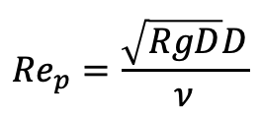
Critical Shields number
In the 1930s Shields determined experimentally that a minimum (critical) shear stress is required to initiate the motion of grains of a deposit composed of non-cohesive particles.
In 1981 Brownlie proposed the following relation for the calculation of the critical Shields number (non-dimensional bed shear stress)
$${Re}_{p}=\frac{\sqrt{RgD}D}{ν}$$
$$τ_{c}^{∗}=0.22{Re}_{p}^{−0.6}+0.06∙{10}^{\left(−7.7{Re}_{p}^{−0.6}\right)}$$
where
Parker et al. modified this relation in 2003 as follows
$$τ_{c}^{∗}=0.5\left[0.22{Re}_{p}^{−0.6}+0.06∙{10}^{\left(−7.7{Re}_{p}^{−0.6}\right)}\right]$$
For large values of the particle Reynolds number (gravel) the critical Shields number is equal to 0.03

Slide 9

Modified Shields diagram
silt
sand
gravel
$$τ_{c}^{∗}$$
The values of Re_{p} at the silt-sand and sand-gravel border are computed with R = 1.65 and ν = 0.000001 m²/s

Slide 10

Threshold of motion, turbulent rough flow over a nearly flat bed
Here we compute a value of the critical Shields number for gravel. A complete analysis can be found in Ikeda (1982) and Wiberg and Smith (1987).
Let’s assume that
the granular bed is composed of uniform sediment with grain size D,
the bed slope S is small (S << 1), and
the bed roughness is only due to the presence of grains (skin friction) so that k_{s} = n_{k}D
and consider the forces acting on an exposed particle (what we did in the static case on slide 6) whose centroid protrudes from the mean bed of n_{e}D.
$$\overline{u}\left(z\right)$$
F_{C}
F_{D}
z

Slide 11
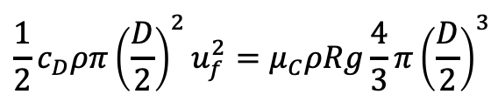

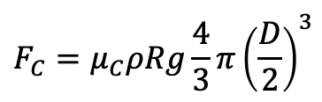
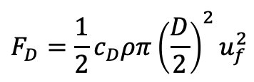
Threshold of motion, turbulent rough flow over a nearly flat bed
Here we compute a value of the critical Shields number for gravel. A complete analysis can be found in Ikeda (1982) and Wiberg and Smith (1987).
Let’s assume that
the granular bed is composed of uniform sediment with grain size D,
the bed slope S is small (S << 1), and
the bed roughness is only due to the presence of grains (skin friction) so that k_{s} = n_{k}D
and consider the forces acting on an exposed particle (what we did in the static case on slide 6) whose centroid protrudes from the mean bed of n_{e}D.
$$F_{D}=\frac{1}{2}c_{D}ρπ{\left(\frac{D}{2}\right)}^{2}u_{f}^{2}$$
impelling fluid drag force
u_{f} = fluid velocity relative to the particle
$$\overline{u}\left(z\right)$$
F_{C}
F_{D}
$$F_{C}=μ_{C}ρRg\frac{4}{3}π{\left(\frac{D}{2}\right)}^{3}$$
Coulomb resistive force
z
$$\frac{1}{2}c_{D}ρπ{\left(\frac{D}{2}\right)}^{2}u_{f}^{2}=μ_{C}ρRg\frac{4}{3}π{\left(\frac{D}{2}\right)}^{3}$$
$$F_{D}=F_{C}$$

Slide 12
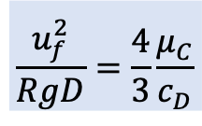
Threshold of motion, turbulent rough flow over a nearly flat bed
Here we compute a value of the critical Shields number for gravel. A complete analysis can be found in Ikeda (1982) and Wiberg and Smith (1987).
Let’s assume that
the granular bed is composed of uniform sediment with grain size D,
the bed slope S is small (S << 1),
the bed roughness is only due to the presence of grains (skin friction) so that k_{s} = n_{k}D,
and we consider the forces acting on an exposed particle (what we did in the static case on slide 6) whose centroid protrudes from the mean bed of n_{e}D.
$$F_{D}=\frac{1}{2}c_{D}ρπ{\left(\frac{D}{2}\right)}^{2}u_{f}^{2}$$
impelling fluid drag force
u_{f} = fluid velocity relative to the particle
$$\overline{u}\left(z\right)$$
F_{C}
F_{D}
$$F_{C}=μ_{C}ρRg\frac{4}{3}π{\left(\frac{D}{2}\right)}^{3}$$
Coulomb resistive force
$$\frac{u_{f}^{2}}{RgD}=\frac{4}{3}\frac{μ_{C}}{c_{D}}$$
z
$$\frac{1}{2}c_{D}ρπ{\left(\frac{D}{2}\right)}^{2}u_{f}^{2}=μ_{C}ρRg\frac{4}{3}π{\left(\frac{D}{2}\right)}^{3}$$
$$F_{D}=F_{C}$$

Slide 13

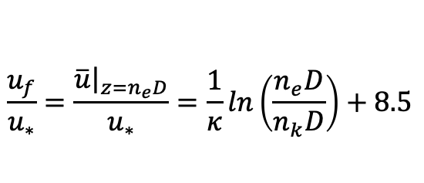
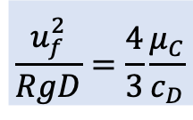
Threshold of motion, turbulent rough flow over a nearly flat bed
$$\frac{u_{f}^{2}}{RgD}=\frac{4}{3}\frac{μ_{C}}{c_{D}}$$
We need to determine u_{f}
$$\overline{u}\left(z\right)$$
F_{C}
F_{D}
As the roughness height and the elevation of the particle centroid are equal to the grain diameter times an order 1 number, the law of the wall is used to compute flow velocity acting on the particle u_{f}.
z
$$\frac{u_{f}}{u_{∗}}=\frac{{\left.\overline{u}\right|}_{z=n_{e}D}}{u_{∗}}=\frac{1}{κ}ln\left(\frac{n_{e}D}{n_{k}D}\right)+8.5$$
NOTE we are assuming that the roughness Reynolds number u*k_{s}/ν > 100 (i.e. hydraulically rough flow)

Slide 14

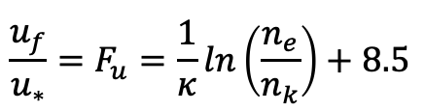
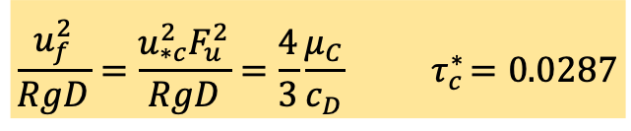
Threshold of motion, turbulent rough flow over a nearly flat bed
$$\frac{u_{f}^{2}}{RgD}=\frac{4}{3}\frac{μ_{C}}{c_{D}}$$
We need to determine u_{f}
$$\overline{u}\left(z\right)$$
F_{C}
F_{D}
As the roughness height and the elevation of the particle centroid are equal to the grain diameter times an order 1 number, the law of the wall is used to compute flow velocity acting on the particle u_{f}.
z
$$\frac{u_{f}}{u_{∗}}=\frac{{\left.\overline{u}\right|}_{z=n_{e}D}}{u_{∗}}=\frac{1}{κ}ln\left(\frac{n_{e}D}{n_{k}D}\right)+8.5$$
NOTE we are assuming that the roughness Reynolds number u*k_{s}/ν > 100 (i.e. hydraulically rough flow)
The above equation is rewritten as
$$\frac{u_{f}}{u_{∗}}=F_{u}=\frac{1}{κ}ln\left(\frac{n_{e}}{n_{k}}\right)+8.5$$
$\frac{u_{f}D}{ν}=\frac{F_{u}u_{∗}D}{ν}=1,000−100,000$
We further assume that
If n_{e} = n_{k} , F_{u} = 8.5 and μ_{C} = 0.7 the condition for the threshold of motion becomes
c_{D} =~0.45
$$\frac{u_{f}^{2}}{RgD}=\frac{u_{∗c}^{2}F_{u}^{2}}{RgD}=\frac{4}{3}\frac{μ_{C}}{c_{D}}{ τ}_{c}^{∗}=0.0287$$
close to the 0.03 asymptotic value of slide 8

Slide 15

Sediment mixtures
How does the threshold of motion vary if the sediment is a mixture of particles differing in size?
Let’s consider the case of uniform coarse gravel. The modified Shields diagram of slide 8 predicts a critical Shields number equal to 0.03. The critical boundary shear stress will thus be
$$τ_{bc}=ρRgDτ_{c}^{∗}$$
We now replace this uniform gravel with a mixture of gravel sizes D_{i} such that the geometric mean diameter of the mixture D_{g} is identical to the size D of the uniform gravel.
For simplicity, we assume that each grain size D_{i} is coarse enough so that the critical Shields number of uniform sediment with grain size D_{i} is equal to 0.03.

Slide 16
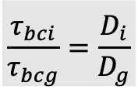



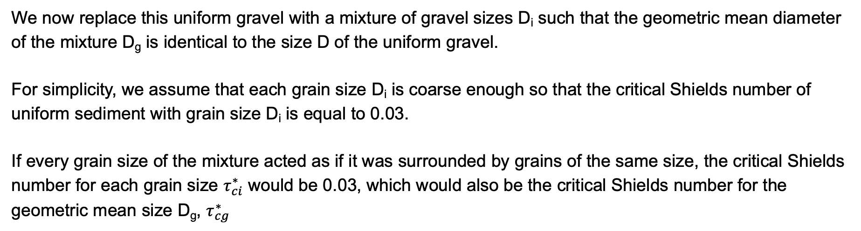
Sediment mixtures
How does the threshold of motion vary if the sediment is a mixture of particles differing in size?
Let’s consider the case of uniform coarse gravel. The modified Shields diagram of slide 8 predicts a critical Shields number equal to 0.03. The critical boundary shear stress will thus be
$$τ_{bc}=ρRgDτ_{c}^{∗}$$
We now replace this uniform gravel with a mixture of gravel sizes D_{i} such that the geometric mean diameter of the mixture D_{g} is identical to the size D of the uniform gravel.
For simplicity, we assume that each grain size D_{i} is coarse enough so that the critical Shields number of uniform sediment with grain size D_{i} is equal to 0.03.
If every grain size of the mixture acted as if it was surrounded by grains of the same size, the critical Shields number for each grain size $τ_{ci}^{∗}$ would be 0.03, which would also be the critical Shields number for the geometric mean size D_{g}, $τ_{cg}^{∗}$
$$τ_{bci}=ρRgD_{i}τ_{ci}^{∗}$$
$$\frac{τ_{bci}}{τ_{bcg}}=\frac{D_{i}}{D_{g}}$$
consequently
and
$$τ_{ci}^{∗}=τ_{cg}^{∗}=0.03$$
$$τ_{bcg}=ρRgD_{g}τ_{cg}^{∗}$$

Slide 17

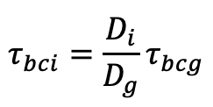


Grain independence
If every grain of the mixture acts as if it was surrounded by particles of its size, the critical Shields number would be the same for all grains and the critical boundary shear stress would linearly increase with grain size D_{i}.
$$τ_{bci}=ρRgD_{i}τ_{ci}^{∗}$$
$$τ_{bci}=\frac{D_{i}}{D_{g}}τ_{bcg}$$
consequently
and
$$τ_{ci}^{∗}=τ_{cg}^{∗}=0.03$$
$$τ_{bcg}=ρRgD_{g}τ_{cg}^{∗}$$
If each grain of the mixture acted as if it were surrounded by grains of the same size of itself, a grain that is twice the size of another grain would require twice the boundary shear stress to be mobilized.
This behavior is called grain independence and it is only mediated by differing grain mass. Large grains are harder to mobilize because they have more mass.

Slide 18

Hiding/exposure
A particle in a mixture does not act as if it was surrounded by particles with its grain size.
Coarse particles are expected to protrude more into the flow compared to the case of uniform coarse sediment. Thus, coarse particles in a mixture feel a larger drag (see slide 11) than in the case of uniform coarse sediment and, consequently, tend to be more mobile than when they are surrounded by particles with the same coarse grain size (exposure effect).
Fine particles tend to hide between coarse grains and, on average, feel a smaller drag compared to the case of uniform fine sediment. Consequently, fine particles in a mixture tend to be less mobile than in the case of uniform fine sediment (hiding effect).
$$\overline{u}\left(z\right)$$
z

Slide 19
Hiding/exposure
A particle in a mixture does not act as if it was surrounded by particles with its grain size.
Coarse particles are expected to protrude more into the flow compared to the case of uniform coarse sediment. Thus, coarse particles in a mixture feel a larger drag (see slide 11) than in the case of uniform coarse sediment and, consequently, tend to be more mobile than when they are surrounded by particles with the same coarse grain size (exposure effect).
Fine particles tend to hide between coarse grains and, on average, feel a smaller drag compared to the case of uniform fine sediment. Consequently, fine particles in a mixture tend to be less mobile than in the case of uniform fine sediment (hiding effect).
Hiding/exposure effects reduce the difference between the critical boundary shear stress required to mobilize particles in a mixture.
$$\overline{u}\left(z\right)$$
z

Slide 20
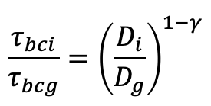
Hiding/exposure
To account for hiding/exposure effects, the relation between the critical boundary shear stress for particles with grain size D_{i} and for the geometric mean size of the mixture D_{g} is modified as
$$\frac{τ_{bci}}{τ_{bcg}}={\left(\frac{D_{i}}{D_{g}}\right)}^{1−γ}$$
where γ is, in general, a number between 0 and 1.

Slide 21
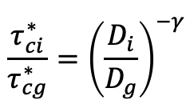
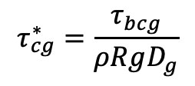
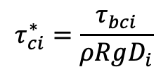
Hiding/exposure
To account for hiding/exposure effects, the relation between the critical boundary shear stress for particles with grain size D_{i} and for the geometric mean size of the mixture D_{g} is modified as
$$\frac{τ_{bci}}{τ_{bcg}}={\left(\frac{D_{i}}{D_{g}}\right)}^{1−γ}$$
where γ is, in general, a number between 0 and 1.
$$τ_{ci}^{∗}=\frac{τ_{bci}}{ρRgD_{i}}$$
$$τ_{cg}^{∗}=\frac{τ_{bcg}}{ρRgD_{g}}$$
Recalling that and
the relation between the critical Shields numbers in the case of sediment mixtures becomes
$$\frac{τ_{ci}^{∗}}{τ_{cg}^{∗}}={\left(\frac{D_{i}}{D_{g}}\right)}^{−γ}$$

Slide 22
Hiding/exposure
To account for hiding/exposure effects, the relation between the critical boundary shear stress for particles with grain size D_{i} and for the geometric mean size of the mixture D_{g} is modified as
$$\frac{τ_{bci}}{τ_{bcg}}={\left(\frac{D_{i}}{D_{g}}\right)}^{1−γ}$$
where γ is, in general, a number between 0 and 1.
$$τ_{ci}^{∗}=\frac{τ_{bci}}{ρRgD_{i}}$$
$$τ_{cg}^{∗}=\frac{τ_{bcg}}{ρRgD_{g}}$$
Recalling that and
the relation between the critical Shields numbers in the case of sediment mixtures becomes
$$\frac{τ_{ci}^{∗}}{τ_{cg}^{∗}}={\left(\frac{D_{i}}{D_{g}}\right)}^{−γ}$$
γ = 0 corresponds to the case of grain independence: the critical Shields number is the same for all particle sizes and the critical bed shear stress linearly increases with the sediment size (larger grains are harder to move because they have more mass).
γ = 1 corresponds to the equal threshold case: the critical Shields number linearly decreases with grain size and all the particles are mobilized at the same value of the boundary shear stress.
In real rivers γ varies between 0 and 1 (but tends to be closer to 1).

Slide 23


Critical Shields number for mixtures of sediments differing in size
$$\frac{τ_{ci}^{∗}}{τ_{cg}^{∗}}$$
$$\frac{D_{i}}{D_{g}}$$

Slide 24


Critical Shields number for mixtures of sediments differing in size
Laboratory experiments and field measurements suggest that a single power law may not be sufficient to describe the variability of the critical Shields number for sediment mixtures.
In particular, as the sediment coarsen, the variability of the critical Shields number with the sediment size decreases. In other words, gamma tends to decrease so that the coarsest fractions tend toward a condition of size independence with a critical Shields number close to 0.015 – 0.02.
$$\frac{τ_{ci}^{∗}}{τ_{cg}^{∗}}$$
$$\frac{D_{i}}{D_{g}}$$

Slide 25
Does a threshold of motion really exist?
In reality there is not a precise threshold of motion.
Very long experiments with Shields numbers significantly smaller than the critical values showed extremely low rates of sediment transport .
Thus, the concept of threshold of motion is invalid but useful.
It denotes conditions in which the sediment transport rate is so small that a deviation from that rate will not cause any morphological change to the channel bed for the time scales of interest (several decades, up to many centuries depending on the problem).

Slide 26
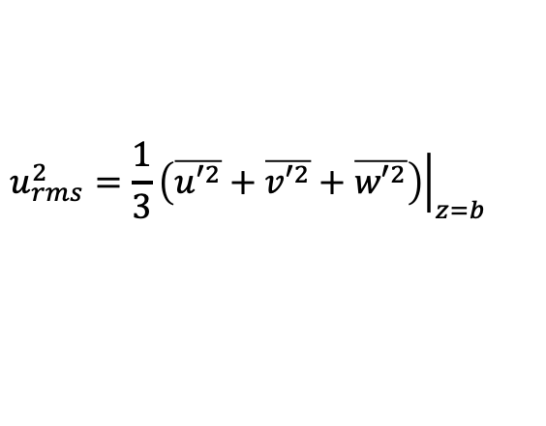

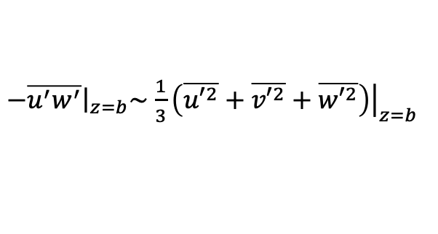
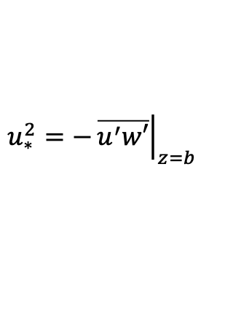
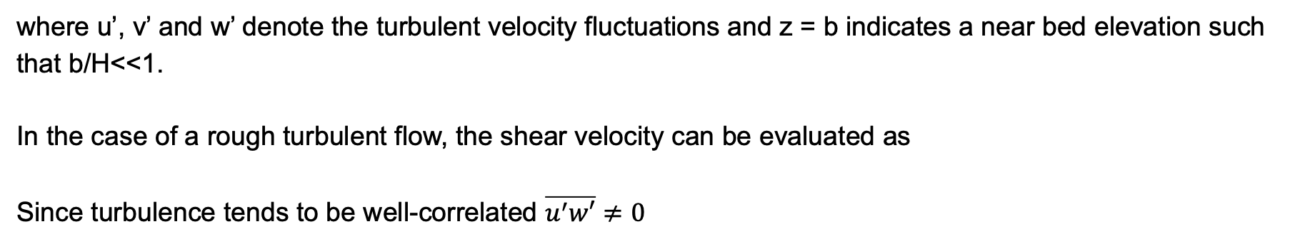
Condition for significant suspension
To maintain a significant amount of sediment in suspension, some measure of the turbulent fluctuations of the flow should be of the same order of magnitude as the particle fall velocity v_{s} of the sediment itself.
Let’s use the root mean square of the velocity fluctuations near the bed u_{rms} as characteristic near bed velocity
$$u_{rms}^{2}=\frac{1}{3}{\left.\left(\overline{{u′}^{2}}+\overline{{v′}^{2}}+\overline{{w′}^{2}}\right)\right|}_{z=b}$$
where u’, v’ and w’ denote the turbulent velocity fluctuations and z = b indicates a near bed elevation such that b/H<<1.
In the case of a rough turbulent flow, the shear velocity can be evaluated as
Since turbulence tends to be well-correlated $\overline{u^{′}w′}≠0$
$$u_{∗}^{2}=−{\left.\overline{u^{′}w′}\right|}_{z=b}$$
$−{\left.\overline{u^{′}w^{′}}\right|}_{z=b}\sim$ $\frac{1}{3}{\left.\left(\overline{{u′}^{2}}+\overline{{v′}^{2}}+\overline{{w′}^{2}}\right)\right|}_{z=b}$
and
$$u_{∗}\sim u_{rms}$$

Slide 27

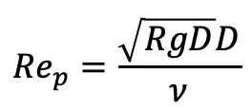
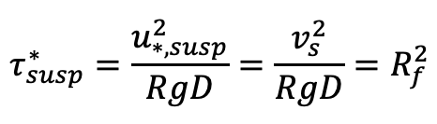


Condition for significant suspension
A loose criterion for the onset of significant suspension is that the characteristic near bed velocity u_{rms} is not too different from the particle settling velocity
$$u_{rms}\sim v_{s}$$
Recalling that in the case of rough turbulent flow
$$u_{∗}\sim u_{rms}$$
A criterion for the onset of significant suspension is
$$u_{∗sus}=v_{s}$$
The above criterion may be expressed in terms of Shields number as
$$τ_{susp}^{∗}=\frac{u_{∗,susp}^{2}}{RgD}=\frac{v_{s}^{2}}{RgD}=R_{f}^{2}$$
where R_{f} is a function of the particle Reynolds number Re_{p} (see notes on sediment characteristics) and
$${Re}_{p}=\frac{\sqrt{RgD}D}{ν}$$

Slide 28


Thresholds of motion and preferential mode of bed material transport
silt
sand
gravel
$$τ_{susp}^{∗}$$
suspended transport
no suspension
bedload transport
no motion
$$τ_{c}^{∗}$$
no motion

Slide 29
References
Brownlie, W. R. (1981). Prediction of flow depth and sediment discharge in open channels. Report No. KH-R-43A California Institute of Technology, Pasadena, California.
Ikeda, S. (1982). Incipient motion of sand particles on side slopes. Journal of the Hydraulic Division 108 HY1, 95-114.
Parker, G., Toro-Escobar, C. M., Ramey, M. and Beck, S. (2003). Effect of floodwater extraction on mountain stream morphology. Journal of Hydraulic Engineering 129 (11), 885-895.
Wiberg, P. L. and Smith, J. D. (1987). Calculations of the critical shear stress for motion of uniform and heterogeneous sediments. Water Resources Research 23 (8), 1471 – 1480.

